Slide 1
Employee Data Analysis using Excel
STUDENT NAME: M.JASEMA BEGUM
REGISTER NO:312216509 autunm1647cb1221647009
DEPARTMENT: B.COM(BM)
COLLEGE:R.B.GOTHI JAIN COLLEGE FOR WOMEN

Slide 2
PROJECT TITLE
Employee Performance Analysis using Excel

Slide 3


AGENDA
Problem Statement
Project Overview
End Users
Our Solution and Proposition
Dataset Description
Modelling Approach
Results and Discussion
Conclusion
3/21/2024 Annual Review

Slide 4

PROBLEM STATEMENT
Employees performance analysis using excel invloves evaluating and measuring an employee‘s work effectiveness and efficiency based on key performance indicators (KPIs).This data is then analyzed using Excel’s functions and tools,such as pivot tables, chats and conditional formatting, to identify patterns,strengths,and areas for improvement.

Slide 5

PROJECT OVERVIEW
The project “Employee Performance Analysis Using Excel “ aims to systematically evaluate employee productivity and effectiveness by leveraging Excel analytical tools. The outcome will help in identifying top performers, recognizing ,training needs and making data-driven decisions for performance improvement.
.

Slide 6
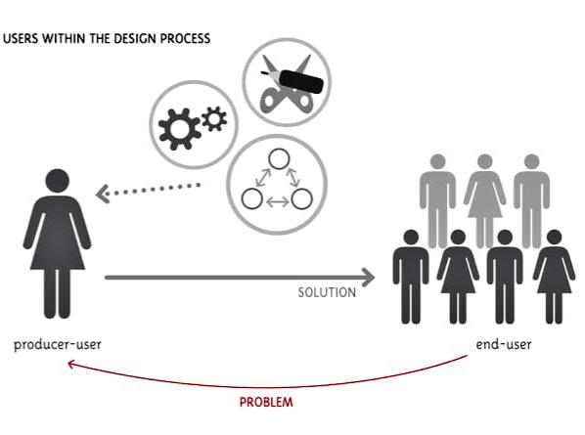

WHO ARE THE END USERS?
Organisation
Employee manager
HRM

Slide 7

OUR SOLUTION AND ITS VALUE PROPOSITION
Data insight Enables managers to make informed decisions Based on Accurate real time performance data.Impovere efficient the Data collection and analysis the process.
Better performance analysis helps in recognition of Performance in Addressing the Under Performance analysis the unlimited data

Slide 8
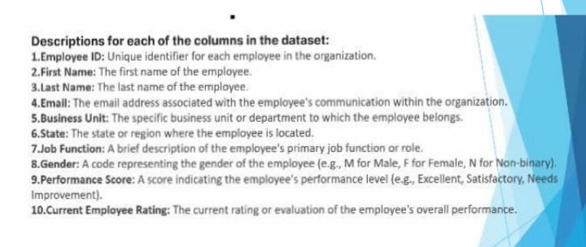
Dataset Description

Slide 9
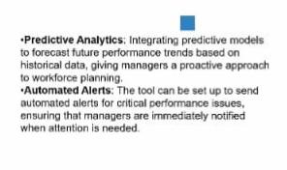

THE "WOW" IN OUR SOLUTION
3/21/2024 Annual Review
9

Slide 10
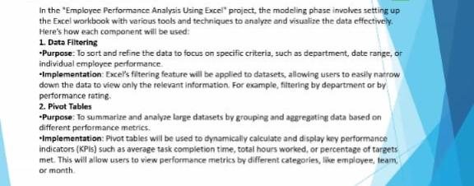
MODELLING
10

Slide 11
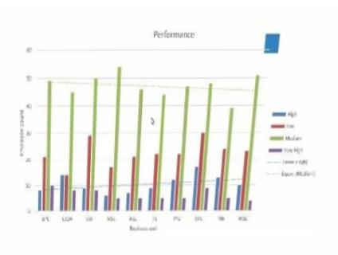
RESULTS
11

Slide 12
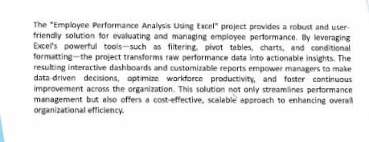
conclusion

